Slide 1
MC4H Implementation Training
A Patient Outreach User Story
Fully Integrated Implementation

Slide 2
Microsoft Cloud for Healthcare
Capability Landscape

Slide 3




Microsoft Cloud for Healthcare - Conceptual Architecture
Connected, highly-integrated healthcare platform
Trusted + global scale + security commitment
Complete, enterprise-ready, end-to-end workflow
Partner ecosystem
Enhance patient engagement
Empower health team collaboration
Improve clinical and operational insights
Personalized
care
Patient
insights
Virtual
health
Care team collaboration
Care
coordination
Continuous patient monitoring
Data interoperability
Clinical
analytics
Operational analytics
Microsoft Cloud for Healthcare Add-On components
(e.g. Templates and workflows, configurations, apps, connectors, and services)
Protected health information (PHI)
Compliance
(e.g. HIPAA, HITRUST, GDPR)
Ingest, enrich, and convert with FHIR, DICOM, and IoMT
(Azure API for FHIR and other connectors)
Your existing health data sources and systems
(e.g. Medical imaging, IoMT, HL7 CCDA, CRM, financial, -omics, third-party data, EMR)
Notes:
<<Seller guidance: this is a conceptual architecture, not a technical/logical architecture>
The Microsoft Cloud for Healthcare
Connected, highly-integrated healthcare platform: enable secure, interoperable data access and scalable AI for protected health information across the care continuum
Trusted + global scale + security commitment: customer data and IP remains in their control + global cloud scale + built on a trusted platform that helps customers meet compliance needs
Complete, enterprise-ready, end-to-end workflow: it’s the only cloud platform that has data and AI workflows (Azure AI, ML), human workflows (Teams), and business process workflows (Dynamics 365 and Power Platform)
The Microsoft Cloud for Healthcare is built on a foundation of security and trust. With built-in connectors and converters, you can securely bring all of your organization’s structured and unstructured data into Azure—Microsoft’s cloud computing platform—from across your systems including EHR, imaging, -omics, 3rd party data, IoMT, billing and finance, and CRM. Easily ingest and enrich any volume, variety, or velocity of healthcare data while gaining cloud computing capabilities and services from the world’s most secure and compliant cloud. With a platform focused on interoperability and integration, you can use your data to power applications and business processes from Power Platform, Microsoft 365, and Dynamics 365. For example, you can ingest, manage, and analyze clinical and demographics data, IoMT data, and patient compliance and leverage applications like the Dynamics 365 Customer Insights dashboard to make sure call center agents and triage nurse have insights from the data at their fingertips.
The Microsoft Cloud for Healthcare SKU provides unique capabilities specifically designed to meet the healthcare’s most pressing needs. With an end-to-end, highly-configurable platform, you can take advantage of healthcare-specific capabilities including bots, portals for patients and care teams, template, apps, AI models and intelligence, custom Power BI dashboards, pre-configured workflows, and more. The SKU is also designed specifically to help healthcare organizations meet industry-specific rules and regulations like HIPAA, HiTrust, and GDPR.
By bringing this all together with the Microsoft Cloud for Healthcare, health organizations can enhance patient engagement, empower health team collaboration, and improve clinical and operational insights, all while protecting health information. To achieve these goals, the Microsoft Healthcare Cloud can be configured to enable key capabilities—important healthcare scenarios from personalized care to virtual health that are crucial to meeting patients’ needs today’s evolving industry.
Microsoft partners also build on and extend core cloud capabilities with healthcare specific apps and platforms for payors, providers, biopharma and MedTech organizations. Some examples include:
Agfa’s XERO Universal Viewer: integration with Microsoft Teams helps medical staff share clinical imaging results quickly and securely throughout a network of medical professionals within Microsoft Teams.
Sensoria Health has developed Motus Smart, the world’s first smart diabetic footwear which leveraged the new Azure IoT Connector for FHIR and Azure Continuous Patient Monitoring with customers
Nuance Dragon Ambient eXperience (DAX): integrates with Microsoft Teams, securely capturing and contextualizing physician-patient conversations within Teams and providing automated clinical documentation for virtual visits.
And Mazikglobal’s MazikCare SaaS app delivers rich functionality for providers and includes the Microsoft Health Bot to enable faster COVID-19 screening and testing
With our partners, we’re reimagining healthcare with innovative tools and services on a highly-configurable, end-to-end cloud platform specifically for the healthcare space. Enabling customers to deliver better care, experiences, and insights to improve global health outcomes.
<Seller guidance: as of GA, the Cloud for Healthcare includes built in Epic integrations, enabling HCOs using Epic EMRs to ingest their EMR records directly into the Cloud for Healthcare. While native integrations for other EMR systems are coming soon, the Cloud for Healthcare is built on open standards and data models, ensuring HCOs using other EMRs can customize their data model to ingest their medical records today.>

Slide 4

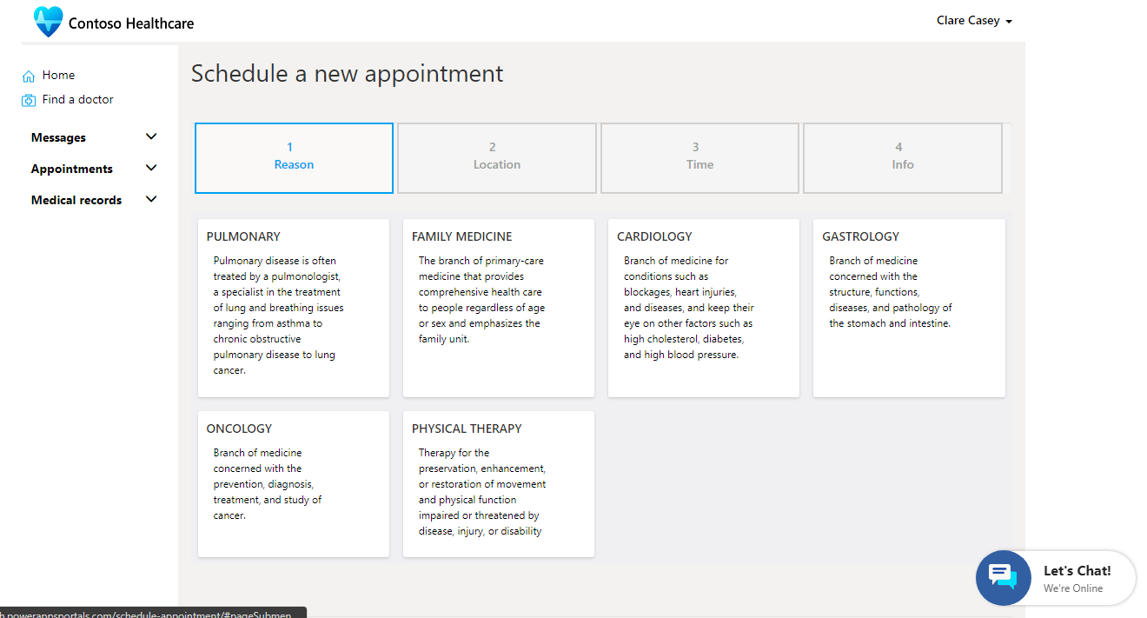
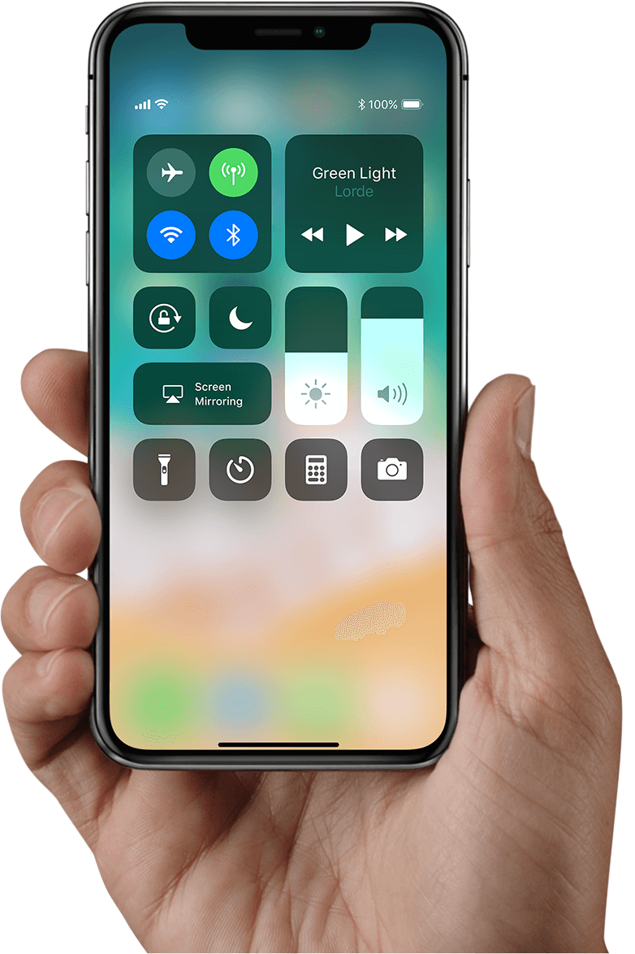
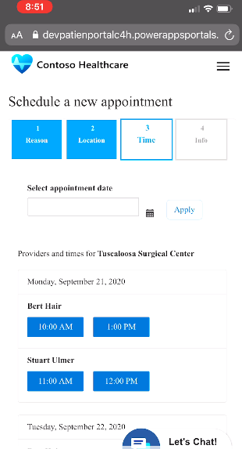
Personalized care
Increase patient engagement by encouraging more active participation through personalized experiences
Patient view
Personalize patient experiences by unifying clinical data from EMR and EHR systems with patients’ consumer information on the Dynamics 365 dashboard
Patient access
Give patients access to services like scheduling, messaging, health bots, and more via an intuitive patient portal built on Power Apps Portal
Patient outreach
Streamline and tailor patient outreach leveraging pre-built, HEDIS-based patient segments and healthcare-specific event templates in Dynamics 365 Marketing
Virtual health bot
Provide a self-service engagement channel by building chatbots from templates in Microsoft Healthcare Bot Service to support COVID-19 risk assessment, scheduling, and more
Notes:
Slide title: Personalized care
The Microsoft Cloud for Healthcare gives you the tools to increase patient satisfaction and build stronger relationships through enhanced, personalized experiences.​ Whether on the go or with a provider, patients can stay engaged in their healthcare to ensure they can schedule appointments or get questions answered when they need. By increasing access to self-service tools and personalizing outreach, your providers ensure every patient gets care tailored to their unique needs.
Let’s take a look at some of the key features included in personalized care:
Patient view: Personalize patient experiences by unifying clinical data from EMR and EHR systems with patients’ consumer information on the Dynamics 365 dashboard
Patient access: Give patients access to services like scheduling, messaging, health bots, and more via an intuitive patient portal built on Power Apps Portal
Patient outreach: Streamline and tailor patient outreach leveraging pre-built, HEDIS-based patient segments and healthcare-specific event templates in Dynamics 365 Marketing
Virtual health bot: Provide a self-service engagement channel by building chatbots from templates in Microsoft Healthcare Bot Service to support COVID-19 risk assessment, scheduling, and more
[Screenshot descriptions]
Give patients a true omnichannel experience to increase their access to care and enable them to engage how, when, and where they want. With a patient portal available on any device, patients can schedule appointments, message their providers, interact with health bots, access knowledge articles and information about upcoming events, and more.
<click>

Slide 5
Patient Outreach Key Feature Summary
Data Platform Features
Dynamics 365 Base Features
MC4H Extensions
Azure Services
Azure API for FHIR
Healthcare APIs (preview)
Open Source (OSS) on Azure
FHIR Server
FHIR Bulk Loader
FHIR Proxy
FHIR Sync Agent
Connectors
Azure FHIR for Power Query
FHIRBase for Power Platform (preview)
FHIRClinical for Power Platform (preview)
Dynamics 365 Marketing
Segmentation
Multi-channel Campaigns (Patient Journeys)
Campaign Automation & Tracking
Event Management
Lead Scoring & Management
Social Engagement
Dynamics 365 Customer Insights
Measures, KPIs and Predictions
Advanced Segmentation
Customer Card (for D365)
Patient Outreach App
Healthcare Branded Outbound Marketing App
Healthcare Data Model (CDM)
Healthcare Forms & Views
Patient Timeline Control
Care Team Visualization Control
Sample Patient Segment & Event Definitions
Dataverse FHIR Interoperability
Sync Admin for FHIR App
FHIR Sync Agent Integration Mgt
FHIR to CDM for Health Mapping
FHIR Synced Clinical Data Mgt Center
Virtual Health Data Tables (preview)
Notes:
The Patient Outreach capability of the Microsoft Cloud for Healthcare is built on a set of FHIR Data Capabilities in Azure and Dynamics 365 base features, with added configurations, examples, and new Apps.

Slide 6








Patient Outreach
A Reference Architecture
Patient
Provider
Care Manager
Desktop
Mobile
Browser
Teams
Power BI
Patient Outreach
D365 Marketing
Patient Segmentation
D365 Customer Insights
Securely store and manage data
Microsoft Power Platform
Key
Clinical Data Sync
D365 FHIR Sync Admin
Structural and Semantic Consistency for Applications
Common Data Model
Microsoft Cloud for Healthcare
Clinical Data Synchronization into Application Layer
Azure FHIR Sync Agent
Clinical Data Access
Microsoft Azure FHIR PQ Connector
Microsoft Product
Azure FHIR Services
Microsoft Healthcare APIs
Other
Managing and Scheduling
PAS
Medical Records
EMR / EHR
Connected Devices
IoMT
Notes:
This high-level reference architecture shows one potential way these pieces can work together for a full stack Microsoft Cloud for Healthcare solution to Patient Outreach. This is a good reference but should be tailored to each customer’s specific use case. For instance, data ingestion from Azure FHIR Services to D365 Customer Insights may use $export to ADLS instead depending on data volume and complexity.

Slide 7
Defining the User Story
A single Patient Outreach User Story

Slide 8
User Story (summary)
As a Patient Engagement manager…
I want an automated process to identify patients who often miss appointments, and inform them of Virtual Visit options
…so that I can improve access to care for those patients
A description of a feature or function from a user’s perspective
Who (User Role), What (Functional Acceptance Criteria), Why (Goal or Desired Outcome)
Notes:
To reduce initial time to value, we recommend focusing on a single User Story that will deliver value to end users quickly. The scope and work breakdown of that user story should then include end-to-end design and implementation of complete data flow through integrated systems and capabilities necessary.

Slide 9
User Story (functional acceptance criteria)
Patient records and historical appointment data are consumed daily from EHR for cohort analysis
Patient cohort (segment) criteria should be based on historical patient appointment status data (cancelled, noshow, fulfilled, etc.)
System will identify members of patient segment automatically based on criteria, members list is updated automatically
Patient records with contact data are consumed into Patient Outreach app and kept up to date from system of record for outreach and interactions
Users can see patient segment definition and members in Patient Outreach app
Users can see measures and insights identified that qualify the members for the segment in the Patient Outreach app
User can define/update email template to be sent from within the Outreach app
System will automatically send all members of the cohort (segment) pre-defined email with a link to Virtual Visit information, or attached document
Users can see patients who have been contacted, success rates, and interactions in the Patient Outreach app
A description of a feature or function from a user’s perspective
Who (User Role), What (Functional Acceptance Criteria), Why (Goal or Desired Outcome)
Notes:
An ideal agile approach focuses on delivery of integrations and capabilities only as required to deliver the first prioritized user story, allowing for effective unit testing of each component, and quicker delivery of value to the users. Therefore, we focus on the acceptance criteria of the user story to drive what needs to be delivered. If a component or configuration isn’t necessary to achieve one of the acceptance criteria, then it is lower priority and should not implemented until dictated by requirements.

Slide 10
MVP Solution Design
Defining the high-level solution to address this single user story

Slide 11
Assumptions & Architecture Principles
FHIR (R4) is the common baseline exchange of health data between the clinical application ecosystem and the patient outreach application ecosystem
A repository of clinical information will be created and maintained in the Microsoft Cloud as the “source of truth”
Clinical information and other patient data will not be replicated into additional data repositories unless necessary to provide required enrichment, analysis, processing, or workflows. Viewing from the source of truth will be utilized wherever possible
Mechanism to retrieve or receive health data from the clinical application ecosystem and transform to FHIR (R4) as necessary for ingestion into repository in Microsoft Cloud is required and not addressed in this exercise
Architecture Principals Starter Kit
Guidelines for solution decision making to ensure design is future-proofed and enables value
conscious of security, compliance, efficiency, agility, performance, growth, longevity, cost, etc.
Notes:
We recommend an organization define a set of Architecture Principals at the beginning of a Cloud for Healthcare implementation, as there will be many different teams and specialties involved. Forming an Architecture Review Board to develop and maintain these principals allow development teams to make design decisions independently without sacrificing standards or consistencies around important concepts.

Slide 12
Technical Gap-Fit to MC4H Capabilities
Designing the Implementation
# | Acceptance Criteria | Enablers | High Level Design
1. | Patient records and historical appointment data are consumed daily from EHR for cohort analysis | Azure API for FHIR Azure FHIR PQ Connector | Patient records with demographic data and all patient appointment data flow from source clinical systems into Azure API for FHIR as a FHIR standard source-of-truth. Will enable all future processing, analysis, visualization, workflows, and user applications. D365 Marketing will be used to enable outreach automation. Patient records will be consumed from and synced with Azure API for FHIR to record activity and interactions around. Customer Insights will be used for identity unification between clinical data sources and application data, to enable patient cohort analysis and segmentation. Data will be consumed and unified from Azure API for FHIR and D365 Marketing. Patient segments will be exported from Customer Insights to D365 Marketing (and refreshed regularly) to enable targeted outreach. Insights and measures that drive segmentation will be viewable through the CI Customer Card add-in.
2. | Patient cohort (segment) criteria should be based on historical patient appointment status data (cancelled, noshow, fulfilled, etc.) | D365 Customer Insights
3. | System updates members of patient segment automatically based on criteria, members list is updated automatically | D365 Customer Insights
4. | Patient records with contact data are consumed into Patient Outreach app and kept up to date from system of record for outreach and interactions | Azure API for FHIR Healthcare Data Model in Dataverse FHIR Sync Agent
5. | Users can see patient segment definition and members in Patient Outreach app | D365 Customer Insights Export to D365 Marketing
6. | Users can see measures and insights identified that qualify the members for the segment in the Patient Outreach app | D365 Customer Insights Customer Card Add-in
7. | User can define/update email template to be sent from within the Outreach app | D365 Marketing Email
8. | System identifies patients in cohort and automatically sends them an email (ongoing) | D365 Marketing Customer/Patient Journey
9. | Users can see patients who have been contacted, success rates, and interactions in the Patient Outreach app | D365 Marketing Customer/Patient Journey and Email Insights
Notes:
With our Acceptance Criteria clearly laid out, we run a gap-fit exercise against the Microsoft Cloud for Healthcare capabilities for Patient Outreach, using the Patient Outreach reference architecture as a guide.
Since there are other user stories on the backlog requiring additional patient data from the EMR, and the customer wants to use intelligent cohort analysis to target their patients, we choose to flow Appointment data into Customer Insights and perform the bulk of our segmentation there.
In order to allow appointments and other segment-driving metrics directly in the user experience for Marketing, we also sync Dynamics 365 patient contact information into Customer Insights to support the Customer Card feature.

Slide 13
Minimum Data Elements and Sources
Designing the Data Integrations
# | Acceptance Criteria | Minimum Data Elements | Source | Target
1. | Patient records and historical appointment data are consumed daily for cohort analysis | Patient [id, meta.lastUpdated, name, birthDate, telecom (system=email)] Patient Resource Reference Appointment [id, status, serviceType, appointmentType, start, participant (type=patient)] Appointment Resource Reference | Azure FHIR Services | D365 Customer Insights
2. | User defines/adjusts patient cohort (segment) criteria based on historical patient appointment status data | See 1 | See 1 | See 1
4. | Patient records with contact data are consumed and kept up to date from system of record for outreach/communications | Patient [identifier, name, birthDate, telecom (system=email)] Patient Resource Reference | Azure FHIR Services | Power Platform Dataverse
5. | User can see patient segment definition and members in Patient Outreach app | Segments with members | D365 Customer Insights | D365 Marketing
6. | User can see measures and insights identified that qualify the members for the segment | Patient [contactid, firstname, lastname, birthdate, EMailAddress1, msemr_azurefhirid] | Power Platform Dataverse | D365 Customer Insights
Resourcelist - FHIR v4.0.1 (hl7.org)
Overview of Microsoft Cloud for Healthcare entities - Common Data Model - Common Data Model | Microsoft Docs
Notes:
Digging deeper into each Acceptance Criteria with data elements, we can define our minimum Data Requirements, mapped to the FHIR specification, to inform our integration architecture and data flow design.
Data model references for both the FHIR standard and the CDM for Healthcare are used to map acceptance criteria into data element requirements.

Slide 14
Missed Appointment
Patient Outreach
High Level Architecture
Patient
Engagement Mgr
Desktop
Mobile
Patient Insight Mgr
Browser
Patient Outreach
D365 Marketing
* The use of the Microsoft Azure FHIR PQ Connector may or may not be the appropriate ingestion mechanism depending on data volume and complexity
Browser
Patient Segmentation
D365 Customer Insights
Securely store and manage data
Microsoft Power Platform
Patient Only
Key
Clinical Data Sync
D365 FHIR Sync Admin
Structural and Semantic Consistency for Applications
Common Data Model
Microsoft Cloud for Healthcare
Clinical Data Synchronization into Application Layer
Azure FHIR Sync Agent
Clinical Data Access
Microsoft Azure FHIR PQ Connector
Microsoft Product
Azure FHIR Services
Microsoft Healthcare APIs
Other
*
Managing and Scheduling
PAS
Medical Records
EMR / EHR
Connected Devices
IoMT
Patient &
Appointments
Notes:
Starting from the Microsoft Cloud for Healthcare reference architectures for Patient Outreach we make adjustments to represent our User Story actors, and make some contextual notes.
Note: at this point in the process, volume and complexity of the data required should be evaluated to determine the appropriate ingestion method into Customer Insights. Future user stories should also be considered to ensure the appropriate long-term architecture is selected.

Slide 15
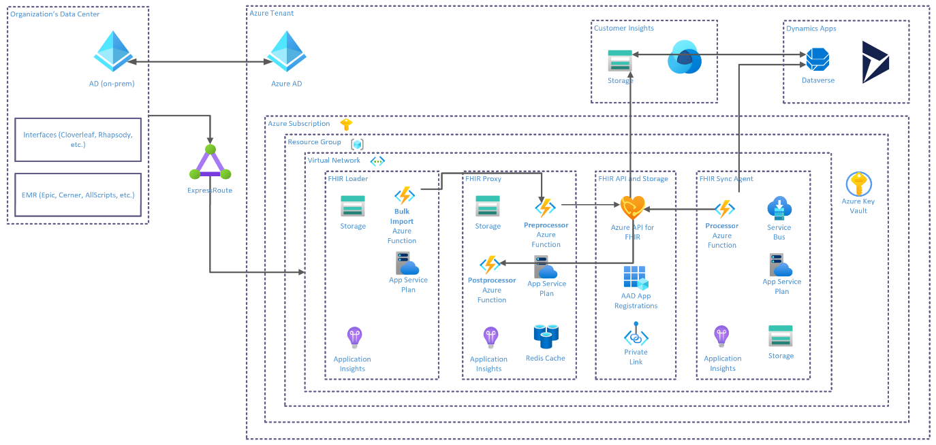
Missed Appointment Patient Outreach
Data Flow
Notes:
Starting from the Microsoft Reference Architecture for Healthcare Data, we add our Target systems of Customer Insights and D365/Dataverse and illustrate data flow. The resulting architecture and flow diagrams, paired with the minimum data requirements definition can be used for any architecture reviews, and to inform the EHR integration team of data required to begin mapping from the source EMR.

Slide 16
Resources
Resource | Description | Type
MC4H Learning Path | Gain a foundational understanding of Microsoft Cloud for Healthcare and its core components, including practical hands-on exercises in your own environment | Microsoft Learn
MC4H Documentation Landing Page | Homepage for documentation, including Overview, Licensing, Set Up Guides, User Guides, What's New, Security & Compliance | Microsoft Docs
MC4H Set up Guide | Top-level set up instructions to deploy Microsoft Cloud for Healthcare components including basic required configurations | Microsoft Docs
Azure API for FHIR Documentation | Official documentation including foundational concepts, quickstarts, tutorials, and how-to guides | Microsoft Docs
About - Microsoft Health Architectures | Microsoft Health Architectures is a collection of reference architectures and, where appropriate, implementations. They illustrate end-to-end best practices for using the Azure API for FHIR and related technologies. | Microsoft Github Repo
Resourcelist - FHIR v4.0.1 (hl7.org) | FHIR Standard resource defenitions | HL7.org Reference Site
Microsoft Cloud for Healthcare entities - Common Data Model | This section provides the information for Microsoft Cloud for Healthcare entities. The modules and associated descriptions are aligned with the HL7 FHIR (Release 4) standards. | Microsoft Docs

